Slide 1
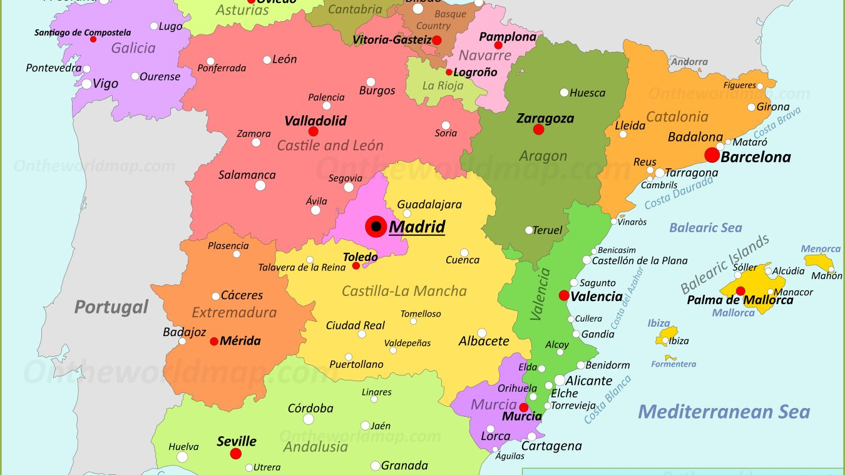
My Dream Visit: Spain
By Aarav

Slide 2
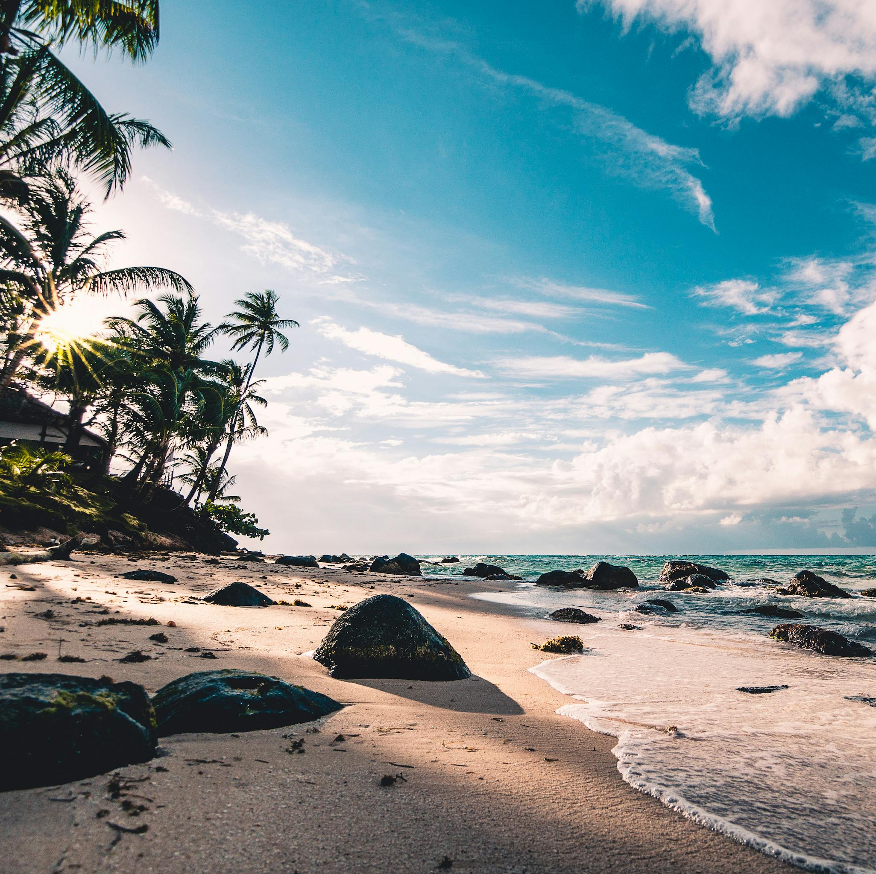
Day 1:Beaches
The thing I like about beaches is not only is it found across the globe but is also very warm so you can relax play with sand, build sandcastles, but the reason I like beaches in Spain is because you can enjoy the lovely, Mediterranean, Spanish sun.

Slide 3
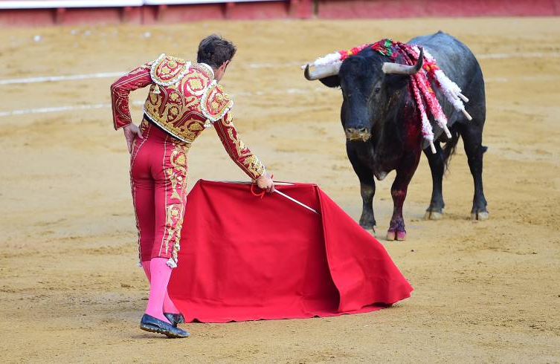
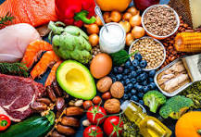

Day 2:Culture and Food
Very fond of both fish and shellfish, Spaniards are among the world's largest consumers of seafood. Legumes, especially lentils and chickpeas, also form an important part of the Spanish diet. Spaniards frequently drink wine and beer with their meals.
These nail-biting “is staged every year from July 6-14th. More than 1 million spectators gather around the streets of Santo Domingo, Mercaderes, and Estafeta to witness the excitement and volatility that characterizes the running of the bulls. Encierros” are the cornerstone event of the San Fermin Festival, which

Slide 4
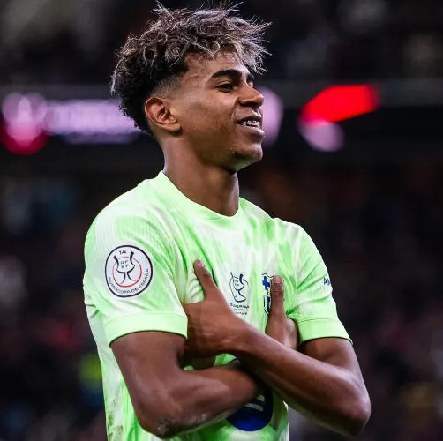
Day 3:Football Match
I am a Barcelona supporter so if I went to Barcelona in Spain I would want to watch a match at home, Camp Nou. It would be a thrilling match and on the top of that I would also [on the way to the stadium ] get some traditional snacks from the stands, outside the stadium.

Slide 5
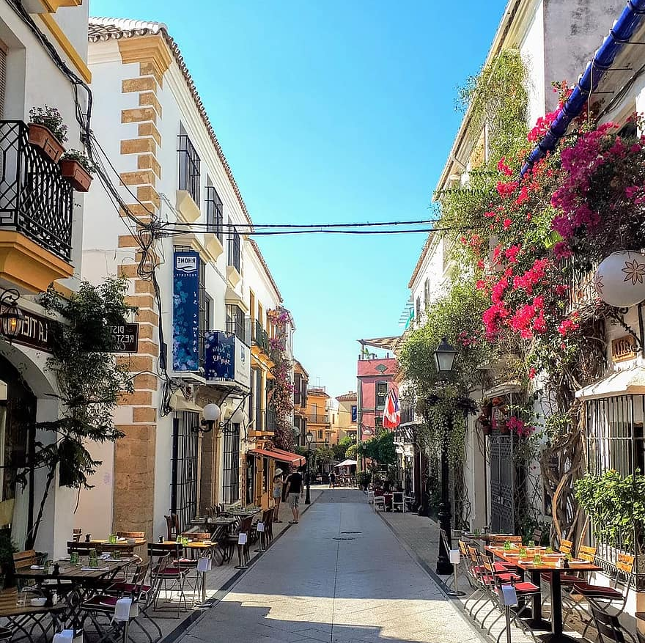
Day 4:Tours
Today I will be touring areas of Spain. First, I would take a walking tour around the stunning mountain views of Seville. Next, I would walk in the beautiful streets of Madrid and to finish the day I would take a long drive through both Madrid and Seville

Slide 6
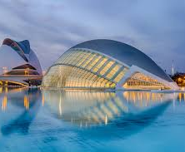
Day 5:Valencia
On the last day of this awesome holiday, I would want to tour Valencia and possibly [ if we have enough time] visit the well known 3D IMAX museum. After that, we would probably watch a famous opera, Madame butterfly.

